Slide 1
LLM Reasoning
Plaban Kumar Bhowmick
Department of AI
plaban@ai.iitkgp.ac.in

Slide 2
What is the Expectation from AI?
Solve the hardest math problems that humans cannot solve?
Discover new scientific theories?
Synthesize new materials or proteins?
Solve AGI?

Slide 3
What is the Expectation from AI?
AI should be able to learn from just a few examples, like what humans usually do
Humans can learn from just a few examples
because humans can reason

Slide 4
Symbolic Reasoning
Input | Output
variation + despite | ap
outdoor + formula | dm
junglee + torso | ??
Rule: Take the middle letter of each word, and then concatenate them

Slide 5
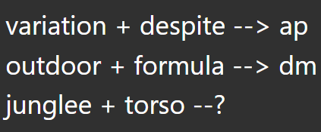
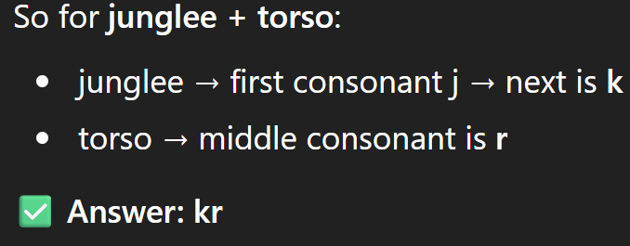
Symbolic Reasoning

Slide 6
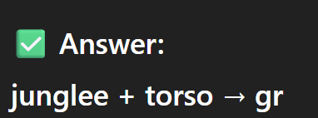
Add Reasoning Steps
variation + despite --> ap
the middle letter of the first word is 'a' and the middle letter of the second word is 'p'. Hence, together they form the output as 'ap’
outdoor + formula --> dm
the middle letter of the first word is 'd' and the middle letter of the second word is 'm'. Together they become 'dm'
Word 1: junglee → letters = j u n g l e e (7 letters) → middle letter = g (4th position)
Word 2: torso → letters = t o r s o (5 letters) → middle letter = r (3rd position)

Slide 7
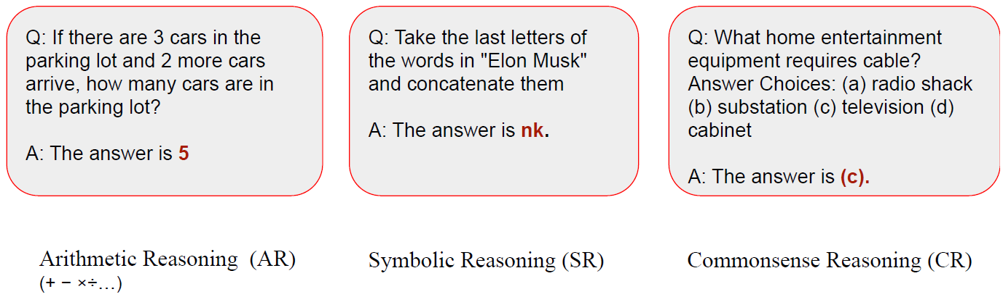
NL Reasoning (NLR) Variations

Slide 8

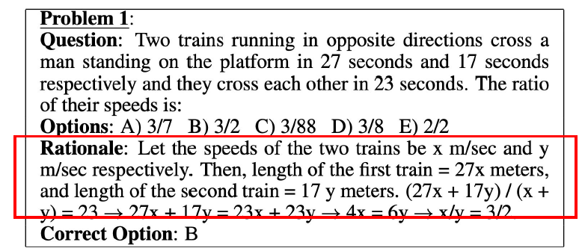
Intermediate Steps are Important
Ling et al 2017 in DeepMind pioneered using natural language rationale to solve math problems by “... derive the final answer through a series of small steps”. Trained a sequence-to-sequence model from scratch.

Slide 9

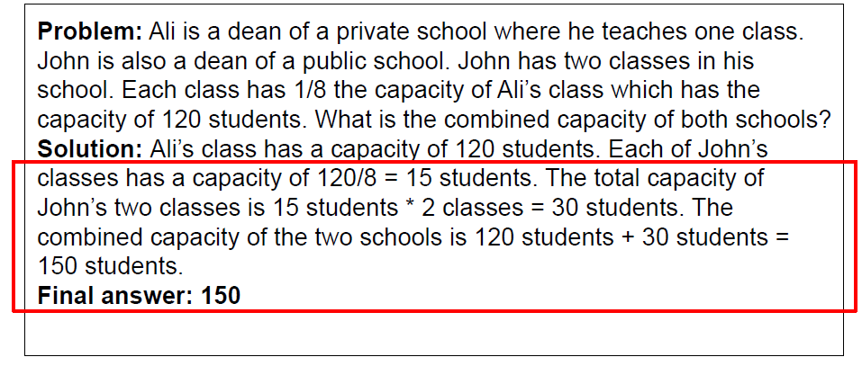
<Problem, Intermediate Steps, Answer>
Cobbe et al 2021 in OpenAI built a much larger math word problem dataset (GSM8K) with natural language rationales, and used it to finetune GPT3

Slide 10
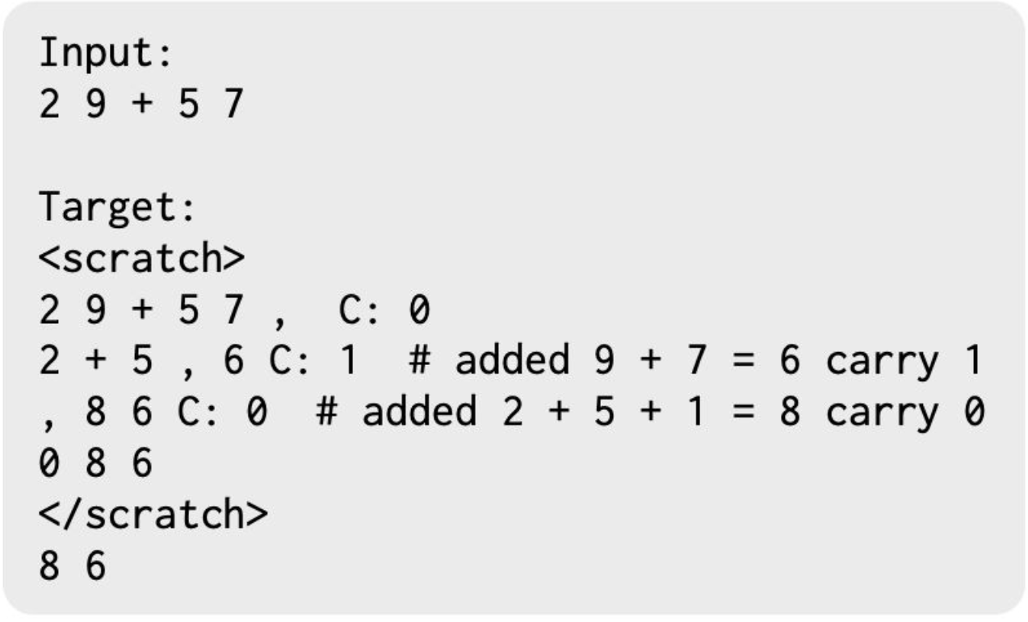

Show Your Work: Scratchpads

Slide 11
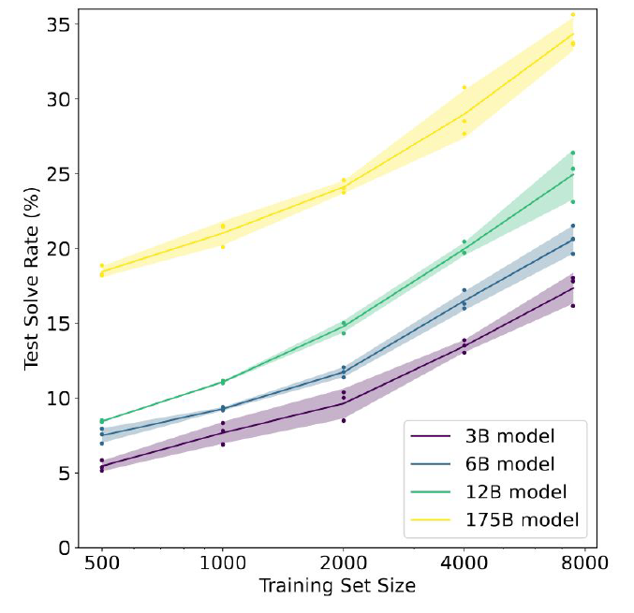
Is Fine-Tuning Enough?
Fine-tune GPT-3 on GSM8K (arithmetic): (Cobbe et al. 2021)
Conjecture:
To achieve > 80%, needs 100 times more fine-tuning data for 175B model

Slide 12
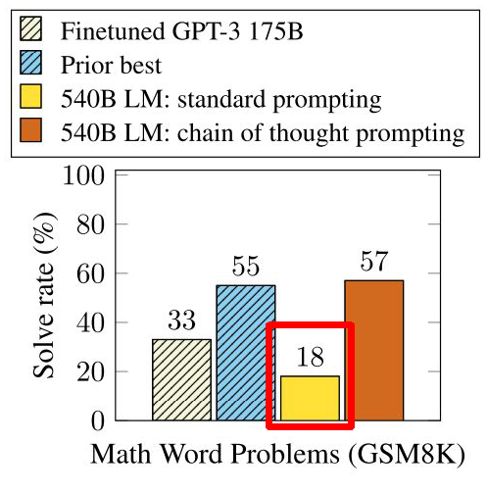
Is Few-Shot Standard Prompting Enough?
Few-shot standard prompting with even larger model (PaLM 540B) also does not work well.
Scaling up language model size does not efficiently achieve high performances, for Arithmetic Reasoning (AR), CommonSense Reasoning (CR) and Symbolic Reasoning (SR) tasks.

Slide 13
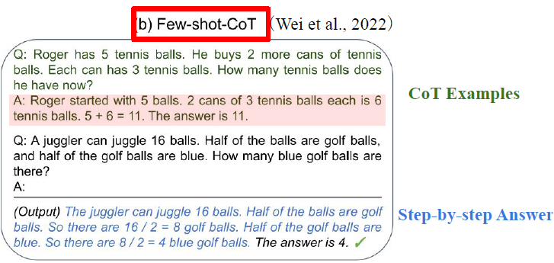
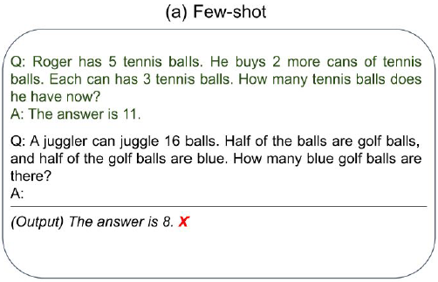
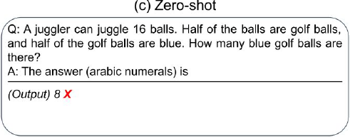
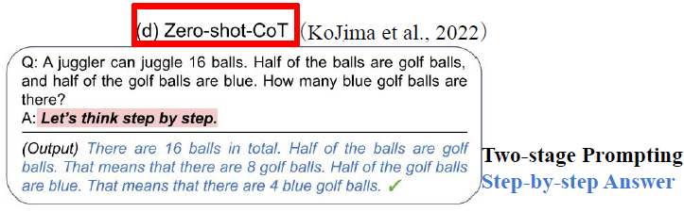
Chain-of-Thought Prompting

Slide 14
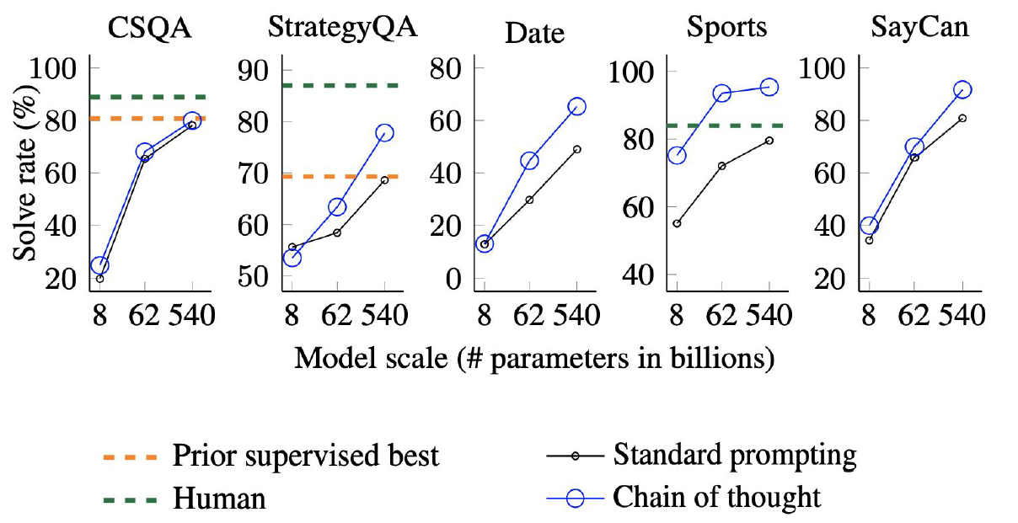
CoT Prompting

Slide 15
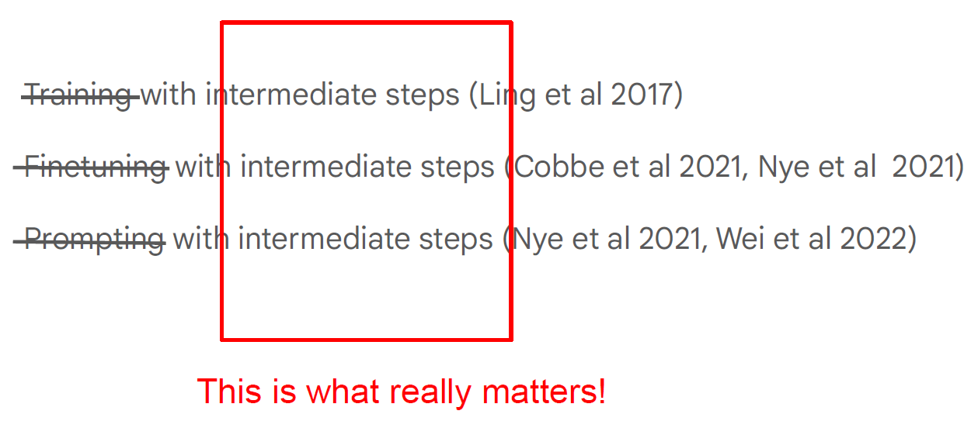
Intermediate Steps are Helpful

Slide 16

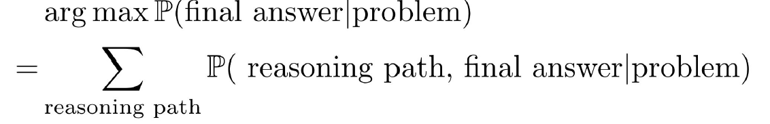
Intermediate Steps Vs. Final Answer
LLM decoding
What we want
Sampling

Slide 17
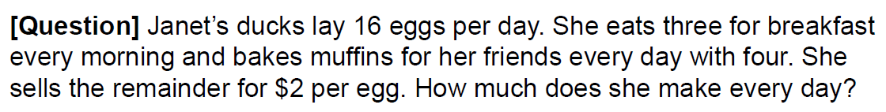

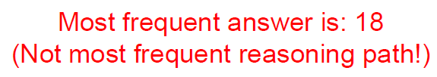
Self-Consistency

Slide 18
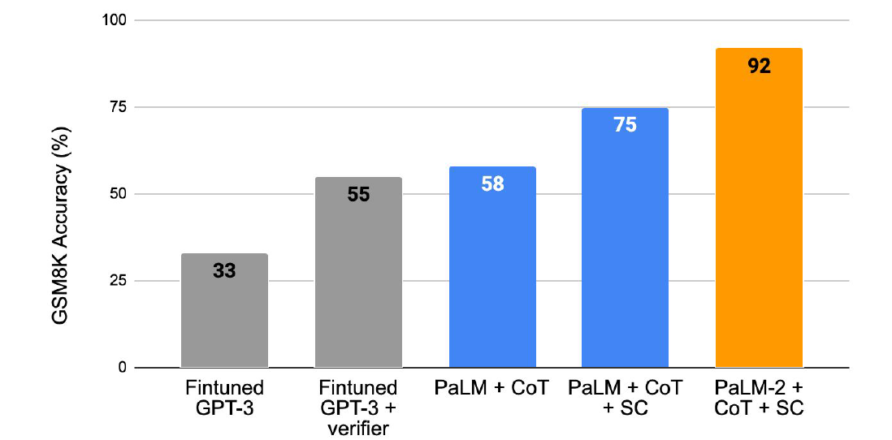
Self-Consistency

Slide 19
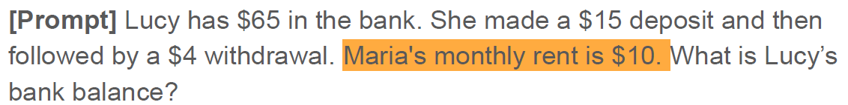
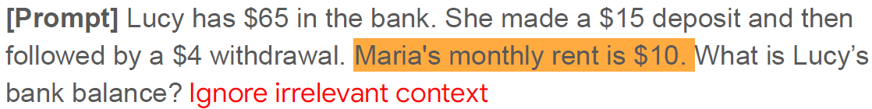
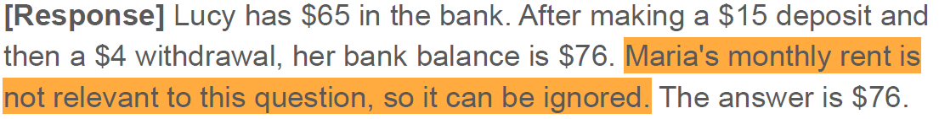
Limitations: Prompt-based Reasoning
Irrelevant Context

Slide 20
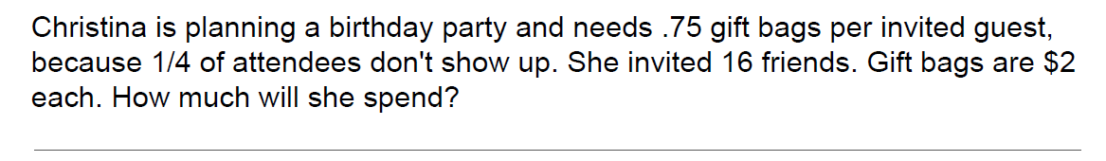
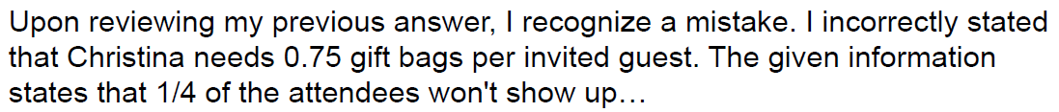
Self-Correction in LLM
Huang et al. Large Language Models Cannot Self-Correct Reasoning Yet. ICLR 2024

Slide 21
Self-Correction in LLM
Terry eats 2 yogurts a day. They are currently on sale at 4 yogurts for $5.00. How
much does he spend on yogurt over 30 days?

Slide 22
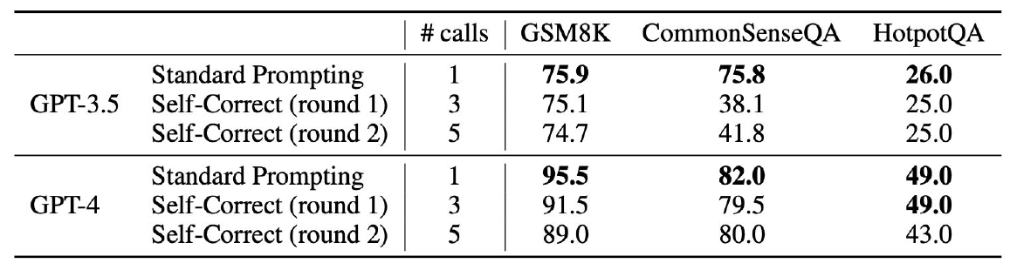
Self-Correction: Performance Drop

Slide 23
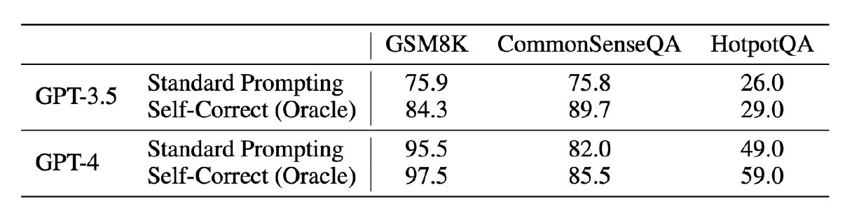
Self-Correction: Oracle
Oracle: Let LLMs self correct only when the answer is wrong

Slide 24
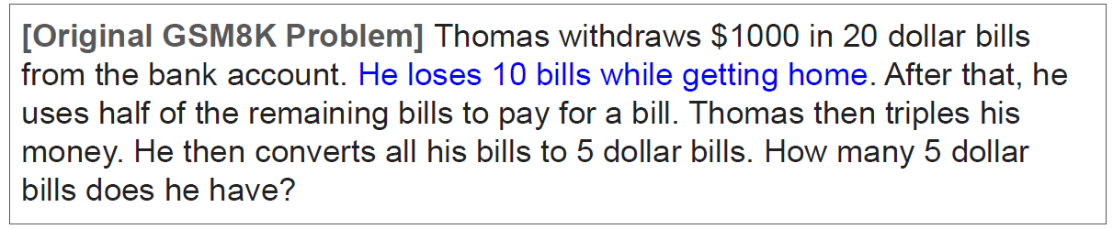
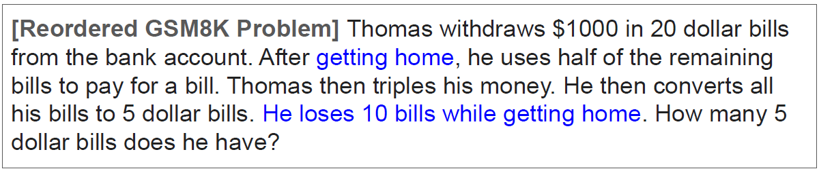
Dependence on Premise Order

Slide 25
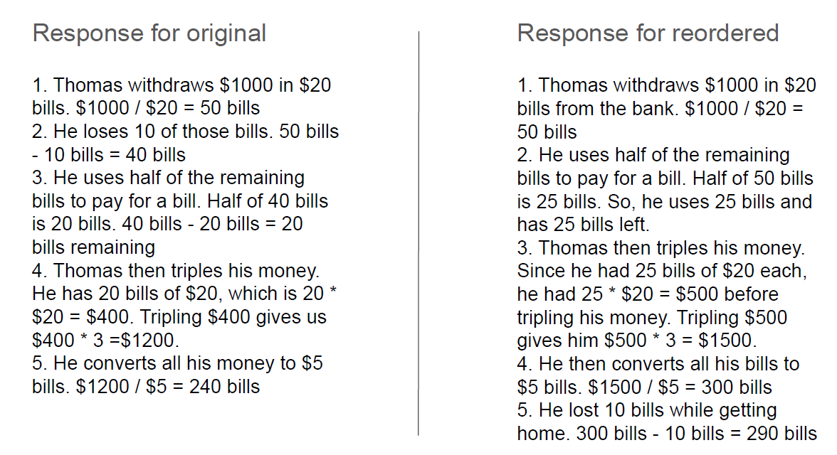
Dependence on Premise Order

Slide 26
A Formal Model
Jun Wang, A Tutorial on LLM Reasoning: Relevant Methods behind ChatGPT o1

Slide 27
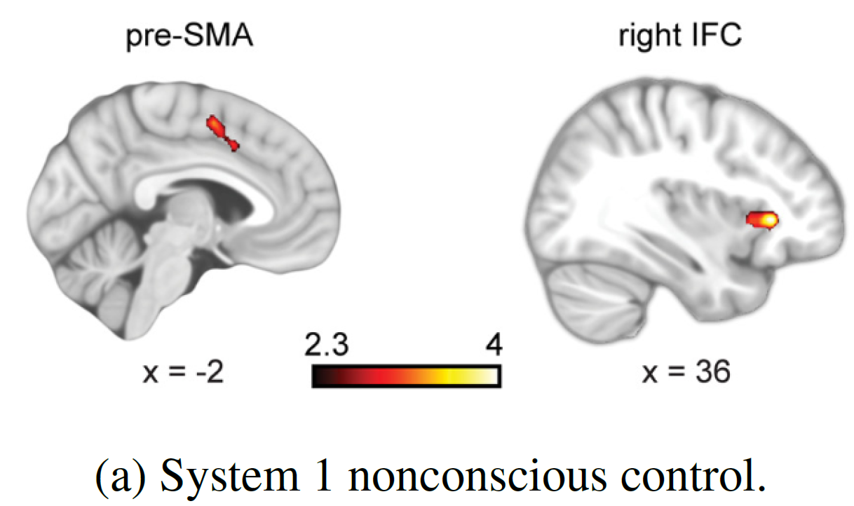
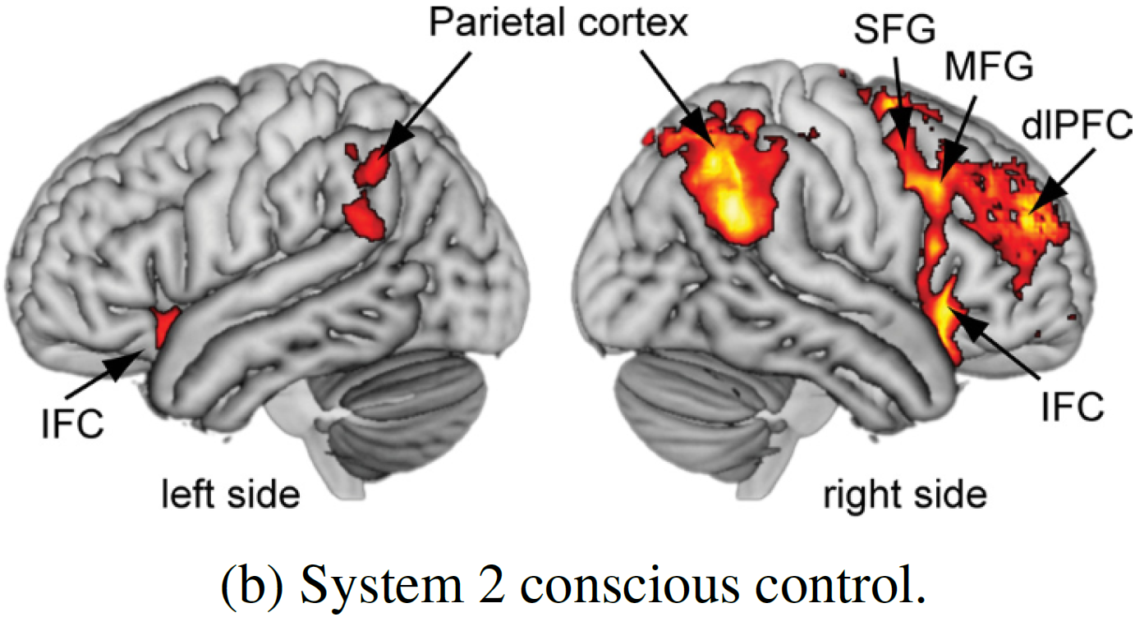
Two Modes of Cognitive Processing
Fast and instinctive, often driven by automatic processes
Deliberate, computational, and in-depth thinking, allowing for careful reflection and thorough analysis

Slide 28
Thinking Deep
Complex problems require deep thought
Deep thinking → Step-by-Step progression
Chain of thought reasoning
“describe your reasoning in steps”
“explain your answer step by step”
Does not truly embed the chain of thought ability
Embedding CoT: Native Chain-of-Thought (NativeCoT)

Slide 29
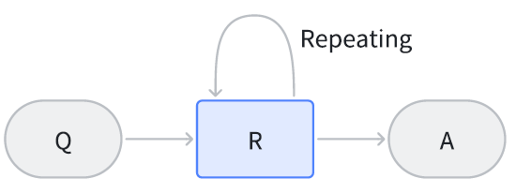
LLM Reasoning Process
Question or Prompt
Reasoning Step
Final Answer

Slide 30
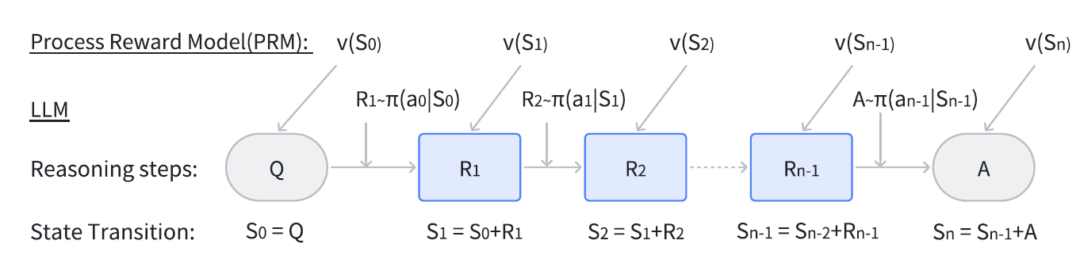
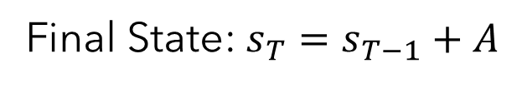
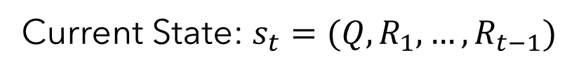
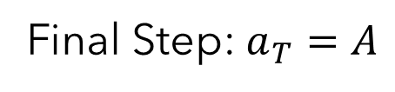
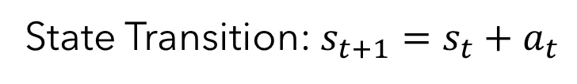
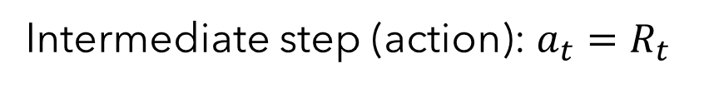

LLM Reasoning: Markov Decision Process
Current State: $s_{t}=(Q,R_{1}, …, R_{t−1})$
$s_{0}=Q$
Intermediate step (action): $a_{t}=R_{t}$
State Transition: $s_{t+1}={s_{t}+a}_{t}$
Final Step: $a_{T}=A$
Final State: $s_{T}=s_{T−1}+A$

Slide 31
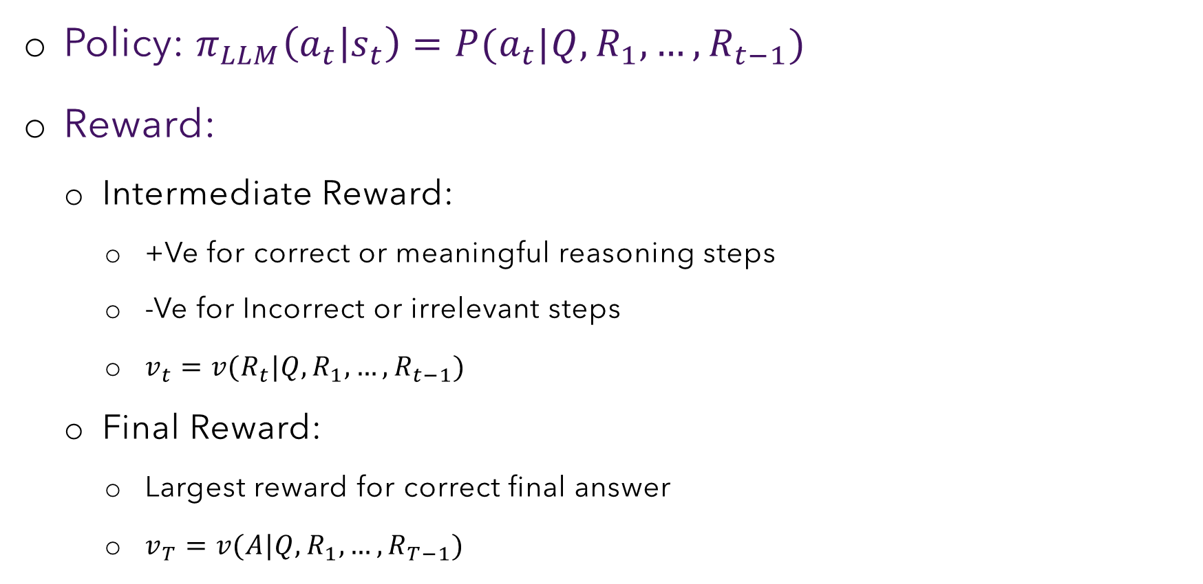
LLM Reasoning: Markov Decision Process
Policy: $π_{LLM}\left(a_{t} | s_{t}\right)=P(a_{t}|Q, R_{1}, …,R_{t−1})$
Reward:
Intermediate Reward:
+Ve for correct or meaningful reasoning steps
-Ve for Incorrect or irrelevant steps
$v_{t}=v(R_{t}|Q, R_{1}, …, R_{t−1})$
Final Reward:
Largest reward for correct final answer
$v_{T}=v(A|Q, R_{1}, …, R_{T−1})$

Slide 32



Token Generation and Reasoning
$$Q$$
$$P(R_{t}|R_{1}, …,R_{t−1})$$
Intermediate steps
$$P(x_{n}|x_{1}, …,x_{n−1})$$
Token for each step

Slide 33
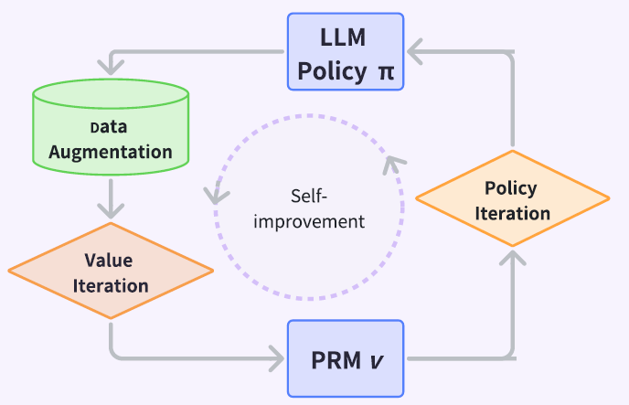
The Workflow

Slide 34






Reasoning Step Data
$$\{R\}$$
$$Q$$
$$R_{1}$$
$$R_{2}$$
$$R_{n}$$
$$A$$
Correct
(1)
Incorrect/
Irrelevant
(0)
Correct
(1)
Manual collection → very costly
Self-Taught Reasoner

Slide 35







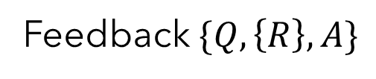
Reasoning Step Data
$$Q,A$$
$$π_{LLM}\left(. | Q, A\right)$$
Feedback $\{Q,\left\{R\right\},A\}$
$$\{R\}$$
$$π_{LLM}\left(. | Q, \{R\}\right)$$
$$π_{LLM}\left(. | Q, \{R\}\right)$$
$$A$$
$$A≈A^{′}$$
Steps are CORRECT

Slide 36
Self-Reinforced Training

Slide 37



Process Reward Model (PRM)
$$s_{t}$$
PRM
$$v_{t}$$
Correct or Incorrect
$$R_{t}$$
How appropriate or effective the generated reasoning step or token is in progressing towards the final answer?
**Outcome Reward Model (ORM) → value depends only on the final outcome

Slide 38
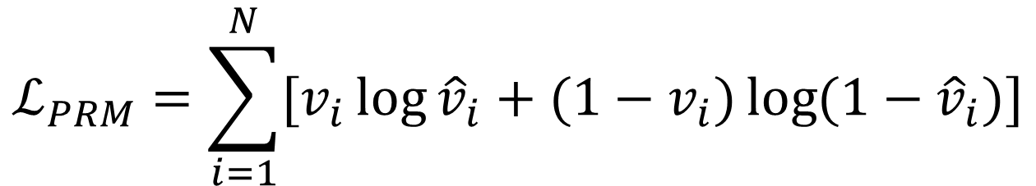
PRM Loss: Classification Method
$$ℒ_{PRM}=\sum_{i=1}^{N}{[v_{i}\log{{\hat{v}}_{i}}+{(1−v}_{i})\log{(1−{\hat{v}}_{i})}]}$$
Just models instant reward; not how it will affect the other subsequent reasoning steps
Whether the reasoning step or answer is correct at that point in the process

Slide 39

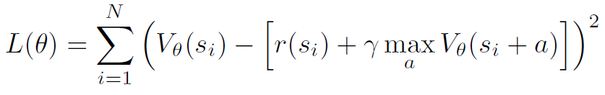

PRM Loss: Value Iteration
Current reasoning step should have effect on future steps
Current value of a state should capture cumulative reward
Value function $V_{θ}(s)$: Expected cumulative reward starting from the state $s$
Estimate by looking ahead
Bellman Target
Loss: squared error between the current value and the Bellman target

Slide 40
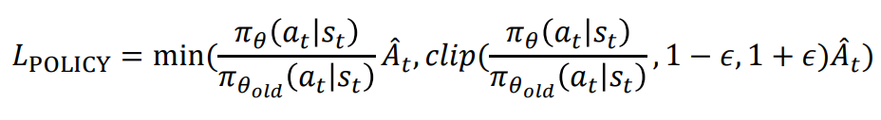



Training Policy: Policy Iteration
Remember PPO?
$$Q$$
Group Relative Policy Optimization (GRPO)
$$\{o_{1}, o_{2}, …, o_{G}\}$$
Compute $A_{t}$ on the group of reasoning steps.
$$a_{i,1}, a_{i,2}, …, a_{i,k_{i}}$$

Slide 41
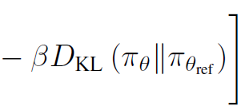


Policy Iteration: GRPO
1
2
5
6
3
4
1
Sampling a question
7
2
Sampling a group of steps
3
4
Average (advantage)
5
6
Average of generating token $t$ under step $i$
7
Keeping the aligned model close to domain

Slide 42
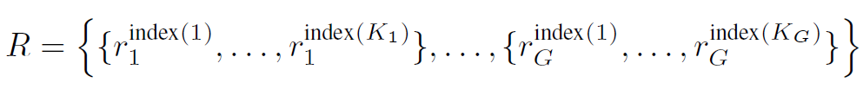
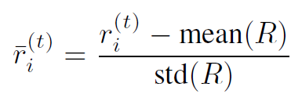
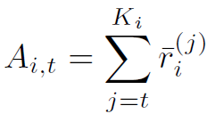
Advantage Function
Rewards are normalised using the rewards across all outputs in the group for a specific question
Let the normalised reward for token $t$ of reasoning step $o_{i}$
$A_{i,t}$ is the sum of normalised rewards from token $t$ to the final token $K_{i}$

